Slide 1

English portfolio
By: Diego Roberto Cuéllar Meléndez 41 “B”

Slide 2
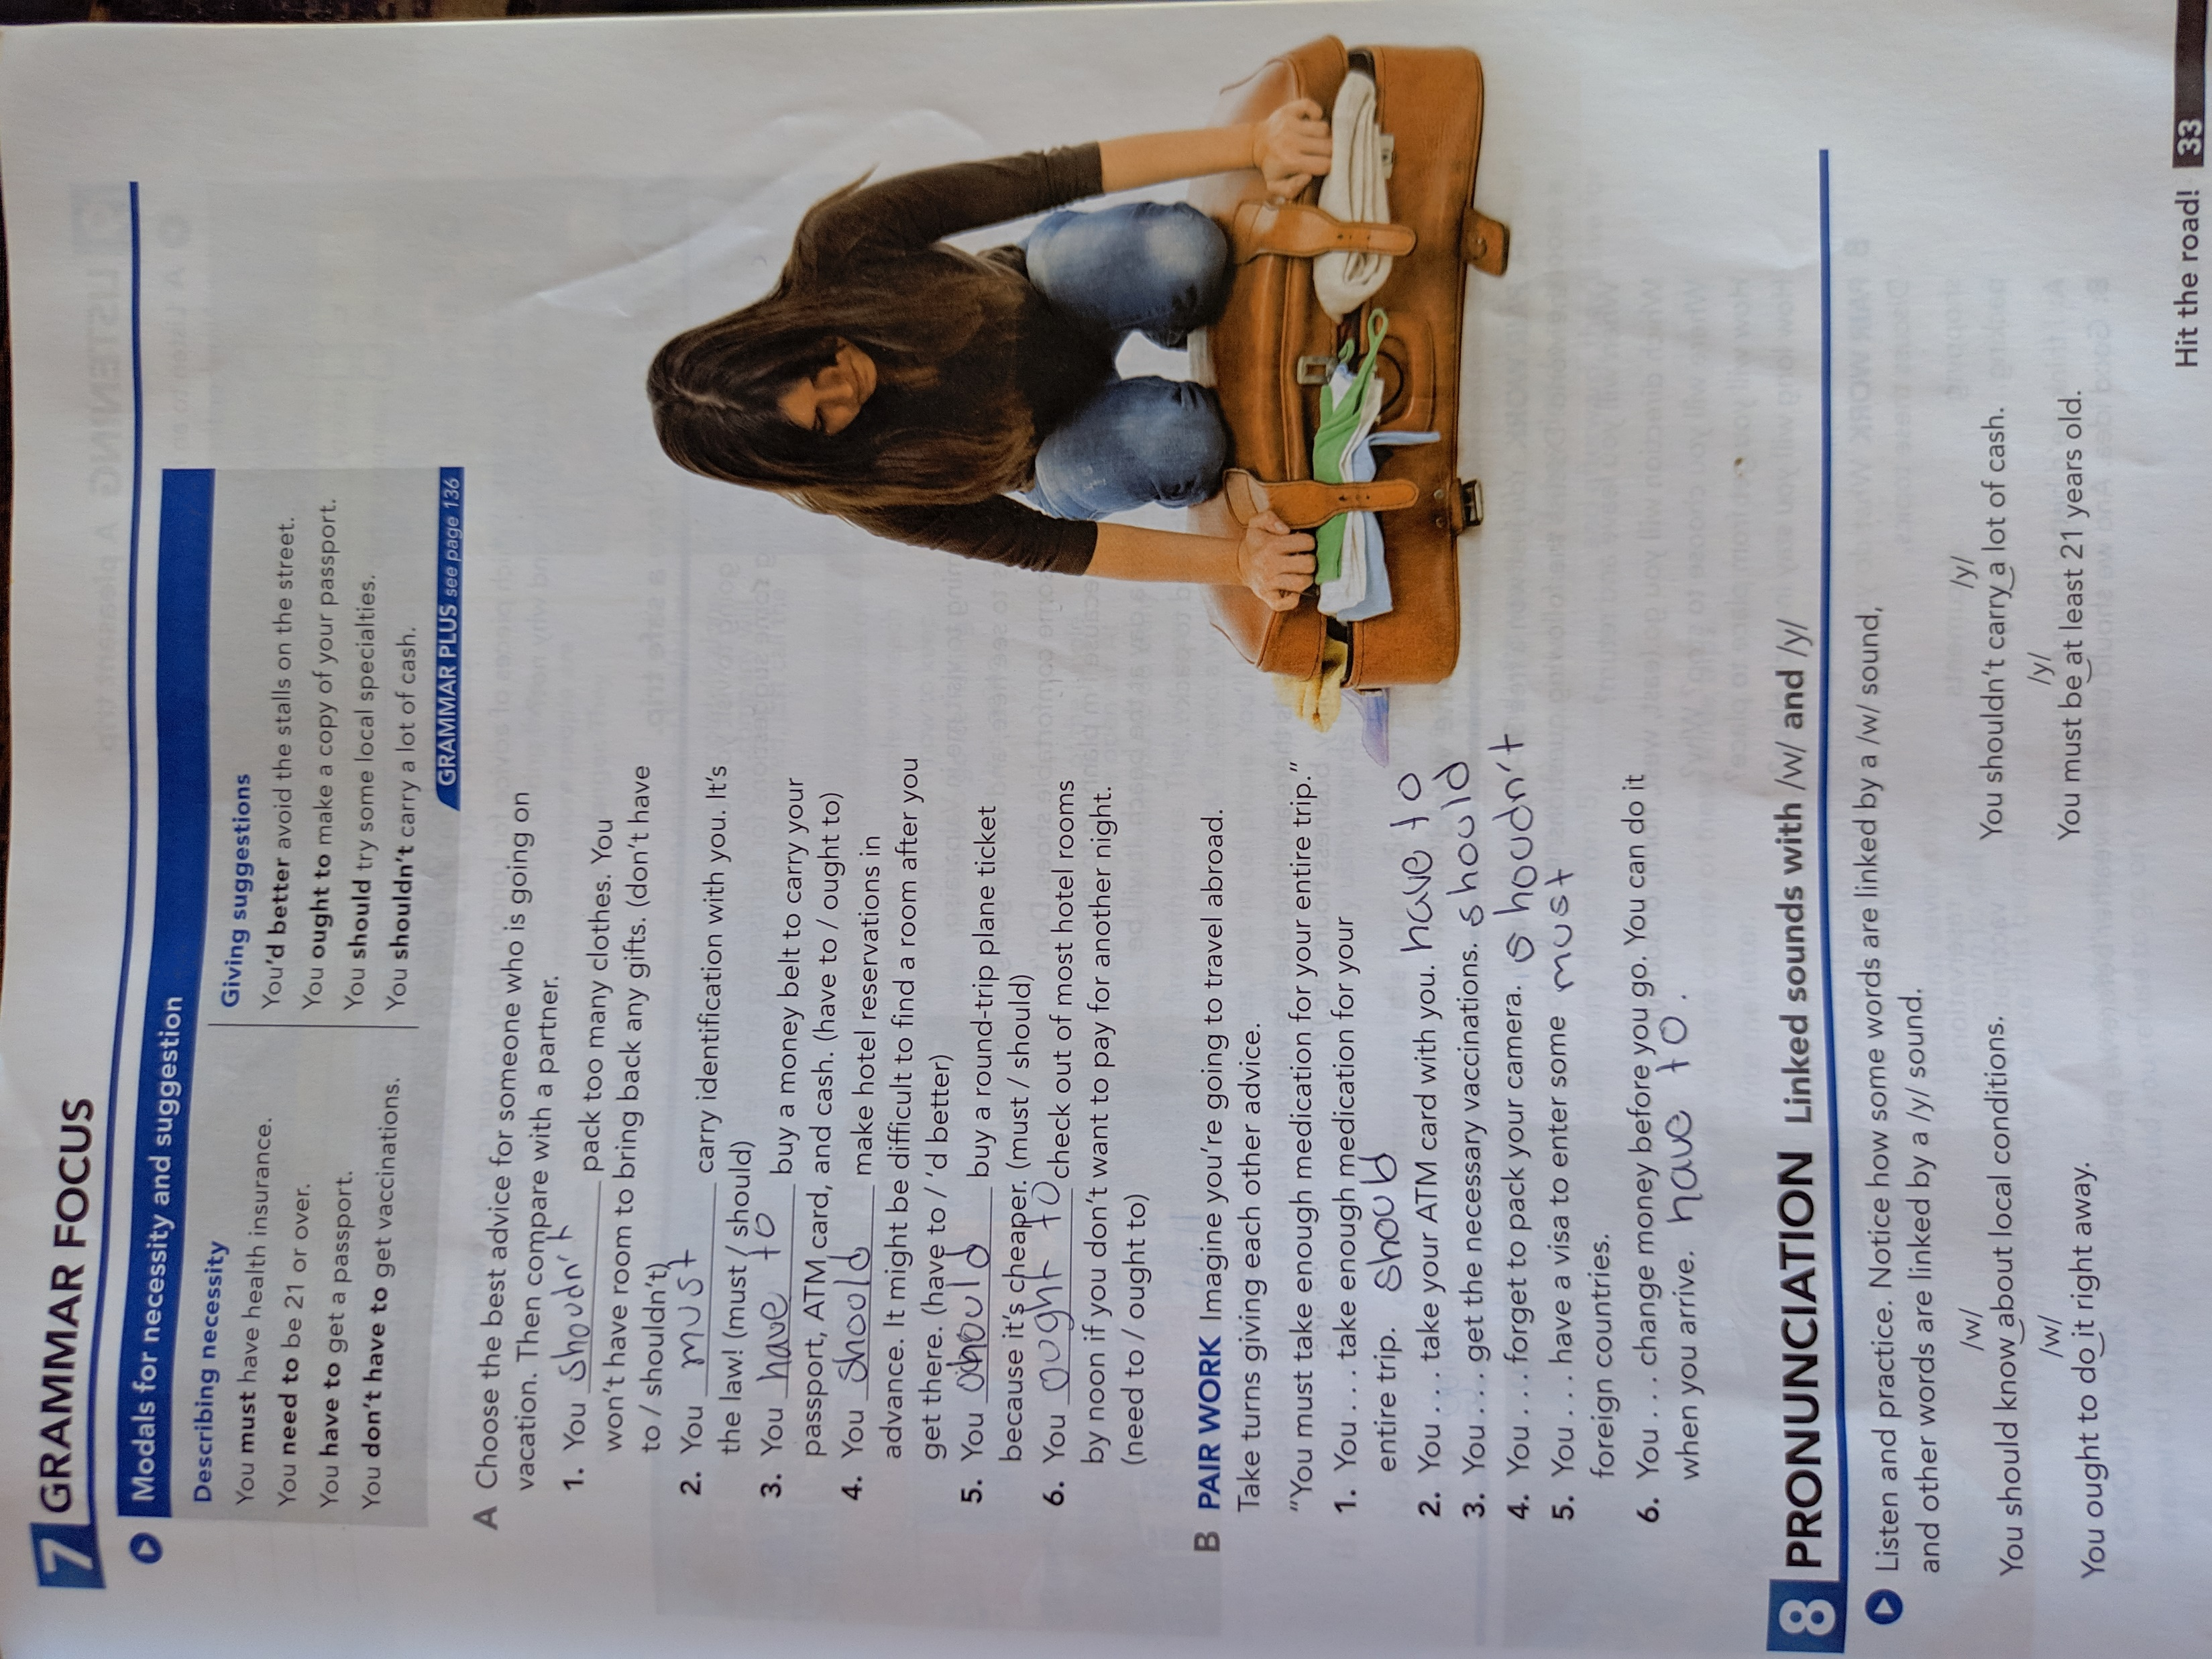
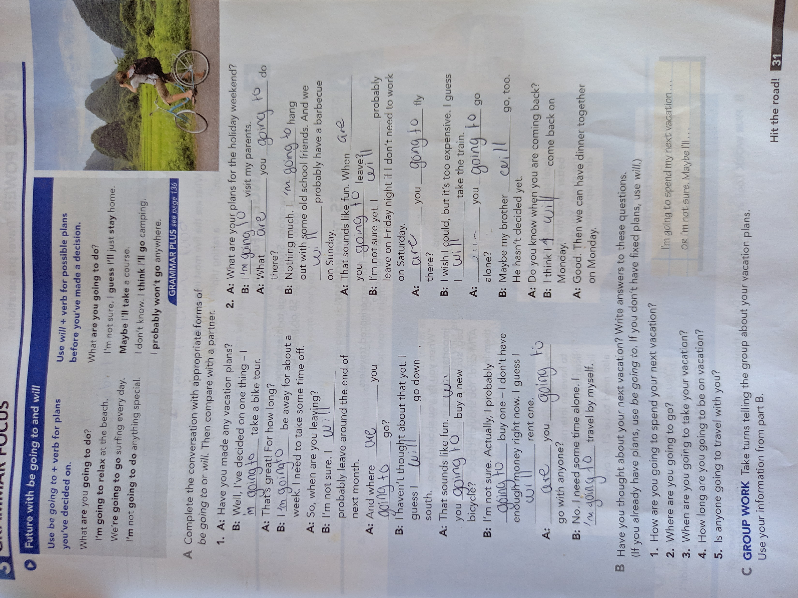
1st

Slide 3
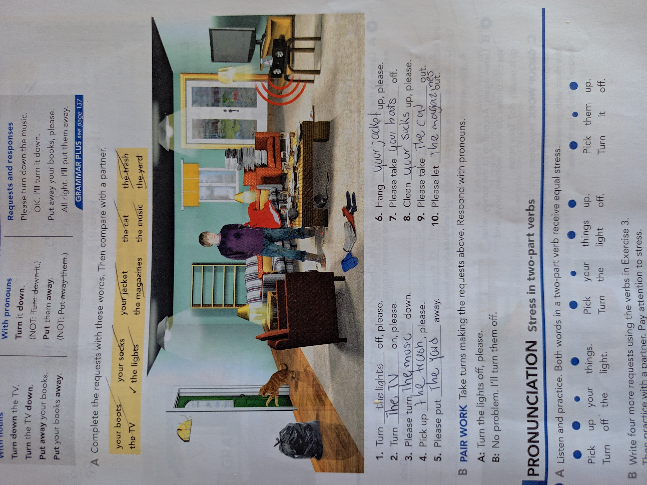
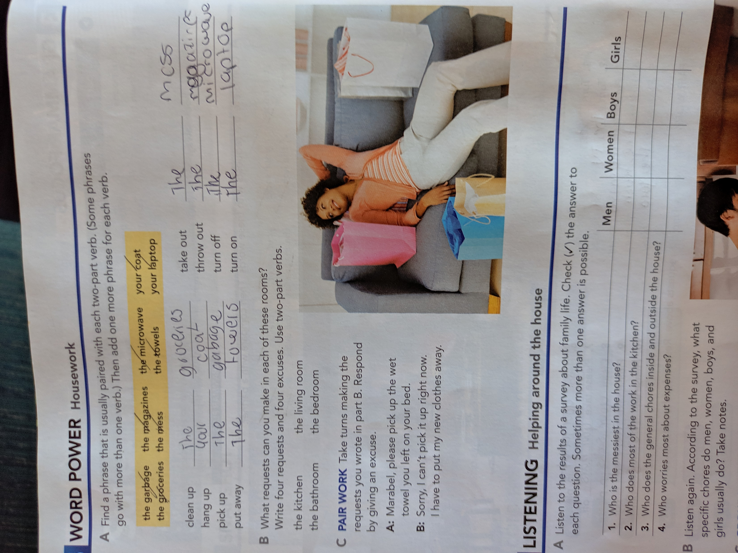
2nd

Slide 4
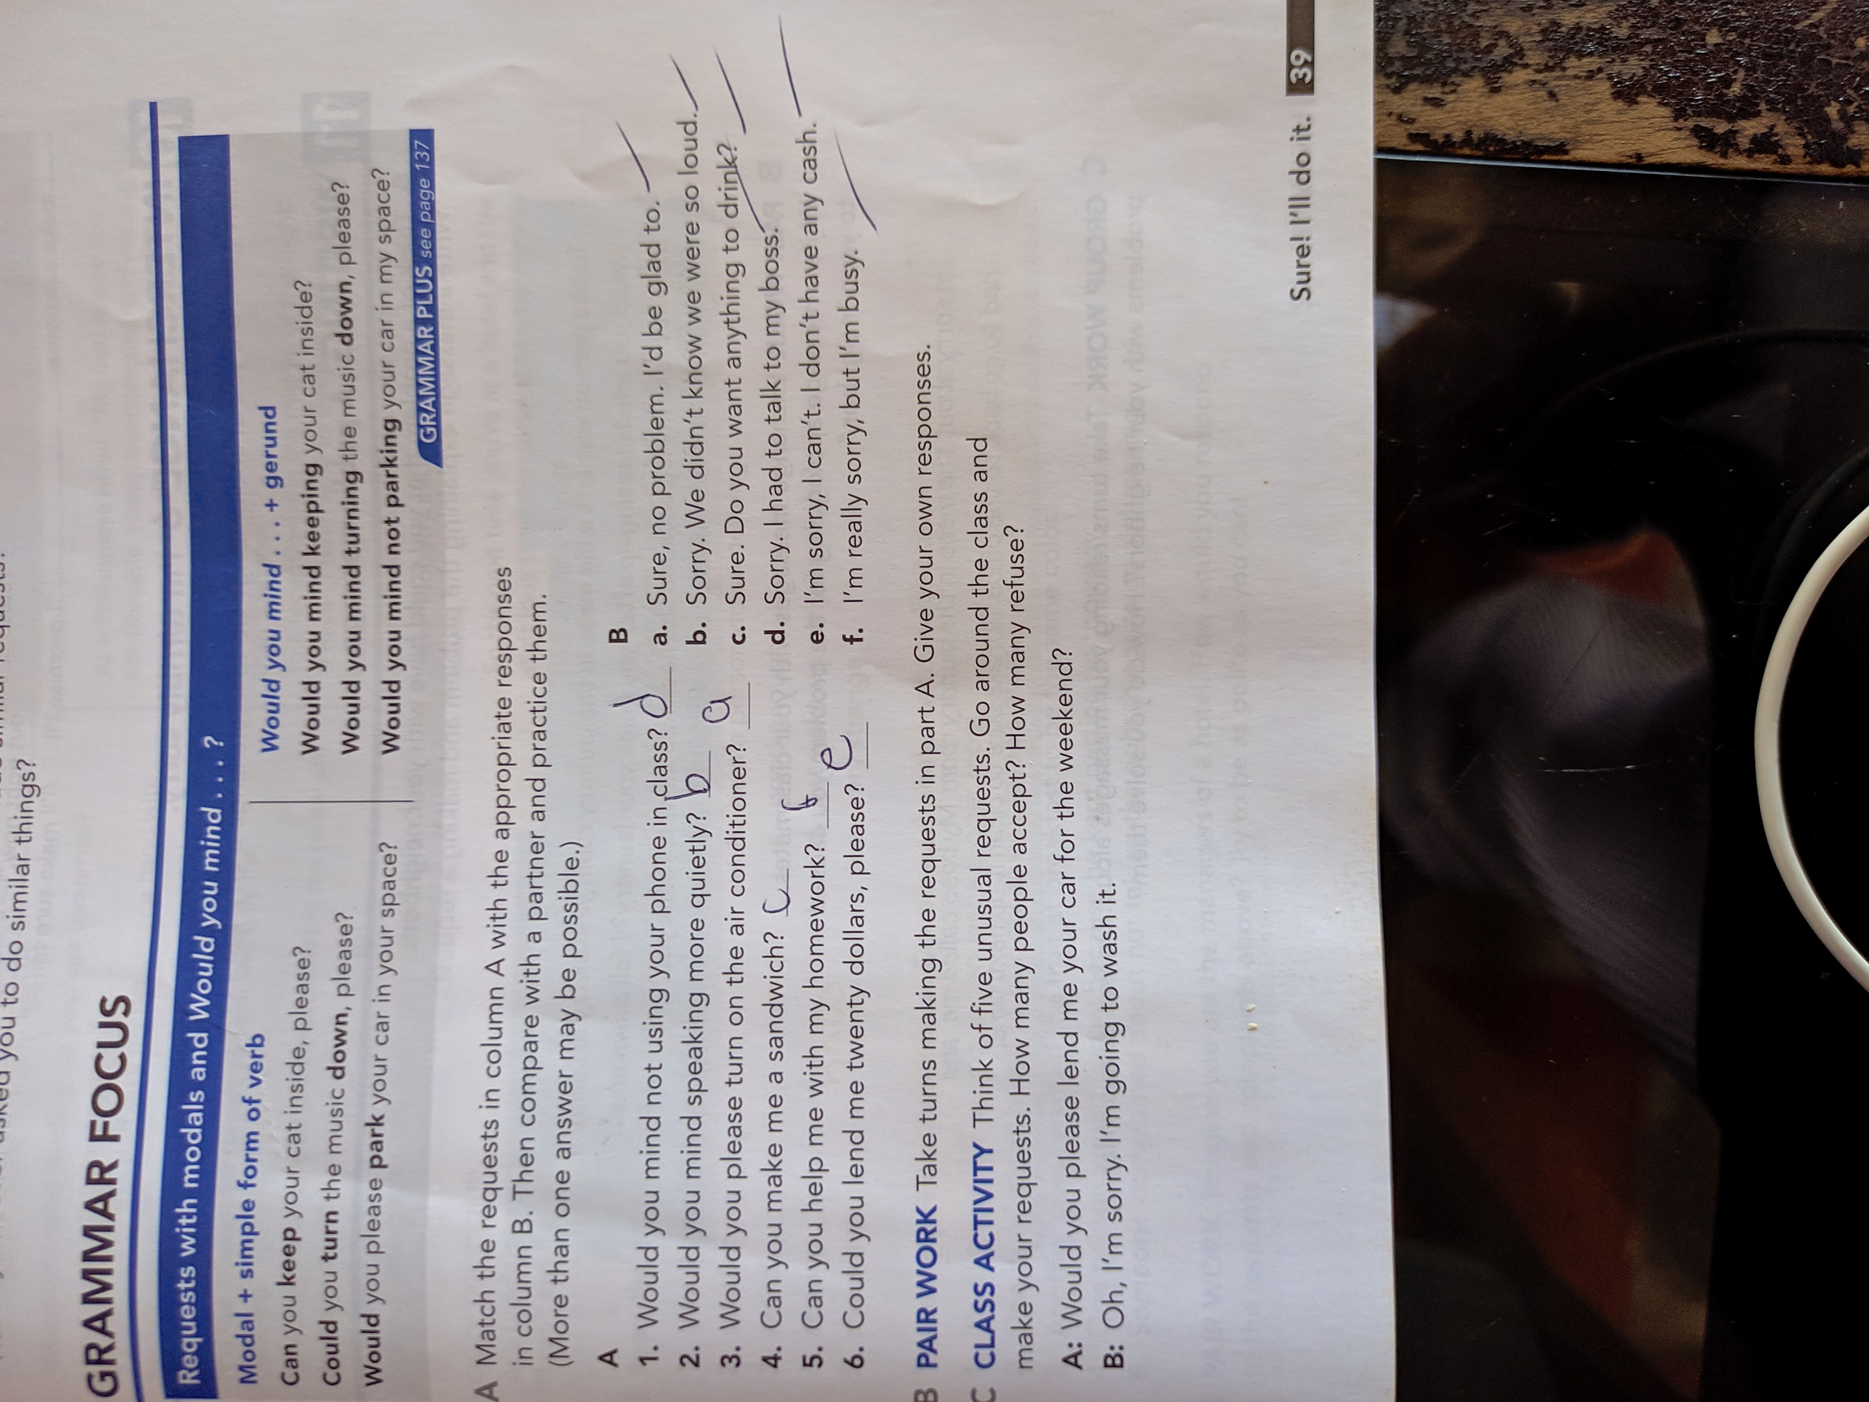
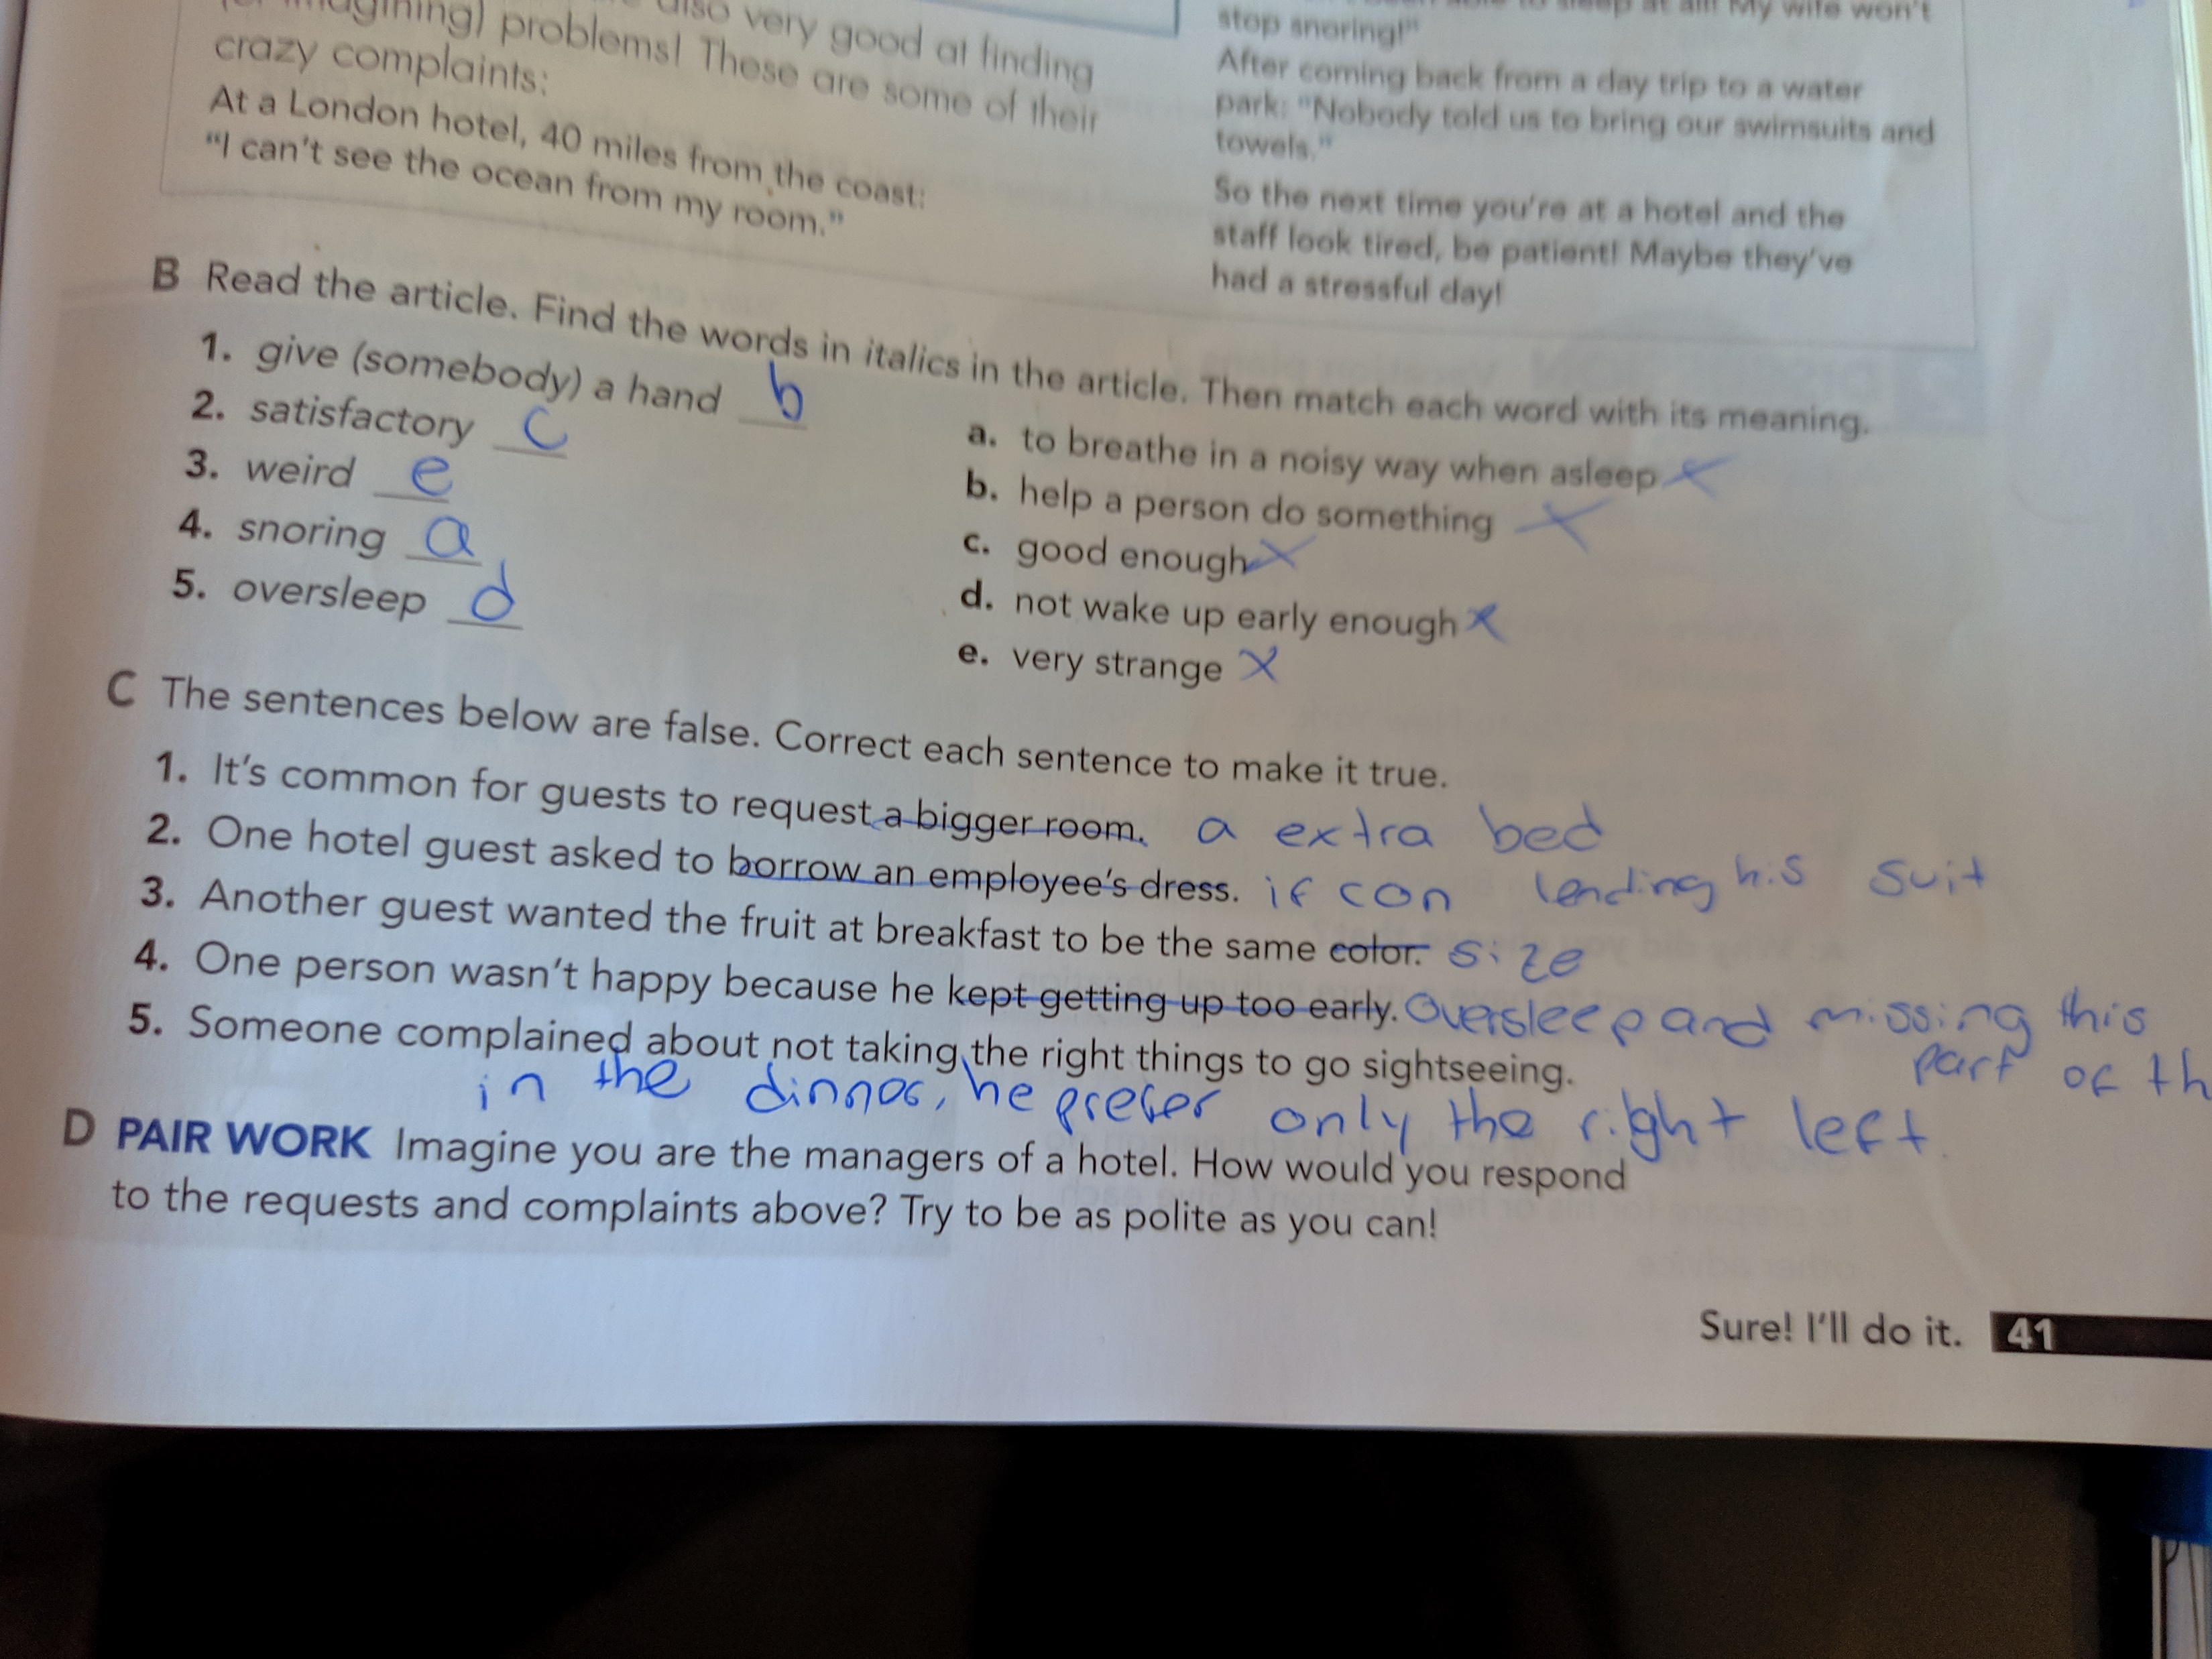
3rd

Slide 5
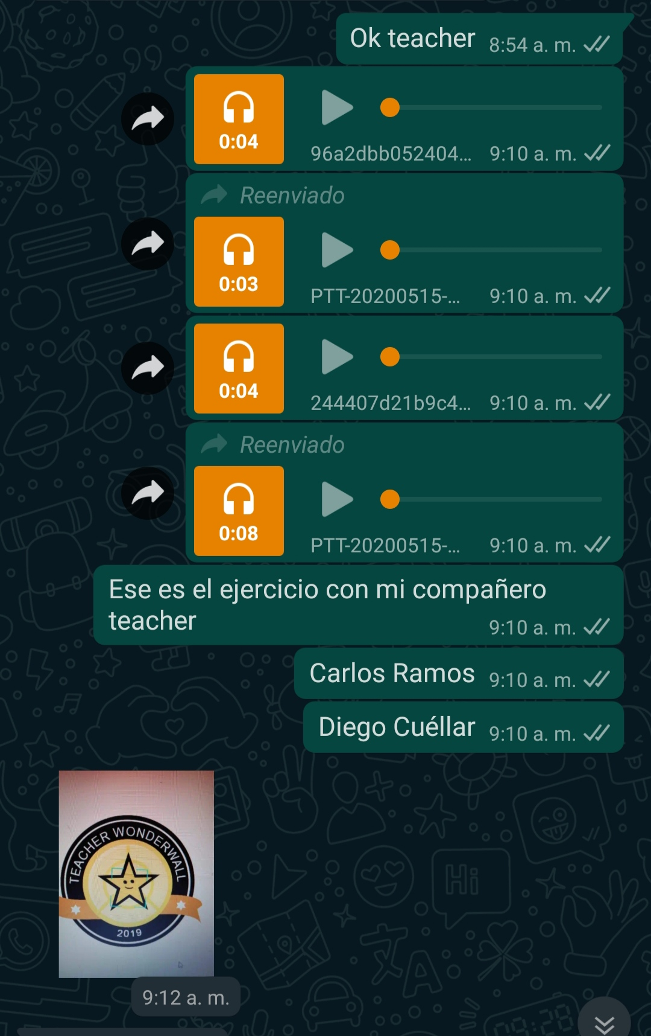
4th
Activity voice.

Slide 6
The LEGO® Story
The short film is first set in Denmark and explores the origin and history of Lego through the experiences of the Kirk Kristiansen family. This includes Ole Kirk Christiansen, Godtfred Kirk Christiansen and Kjeld Kirk Kristiansen. They all took significant roles in changing and shaping the Danish Lego company to be what it is today. The short film conveys the significance of family, inspiring and supporting one another during tribulations and adversity. The company of Lego was founded by Ole Kirk Chrstiansen and his son Godtfred back in 1932. The word “Lego” derive from two Danish words, “leg” and godt”, which translates to “player well” and in Latin translates to “I put together”. The product of Lego was very different from what it is today. In the short film, the company started out making wooden toys in 1932. It was during this time Godtfred saved time and money by putting less work into making the toys. Ole Kirk Chrstiansen was not impressed and was in fact disappointed. Ole Kirk Chrstiansen got his son Godtfred to work on the toys again. That day they learnt an important lesson that the high quality of the toys and honesty of the customers were important. This led to the central idea that “Only the best is good enough”. It was in 1946 when the plastic block was introduced which was later iterated and improved during the mid-1950s to become the modern Lego brick. This was also around the company introduced the Lego system

Slide 7
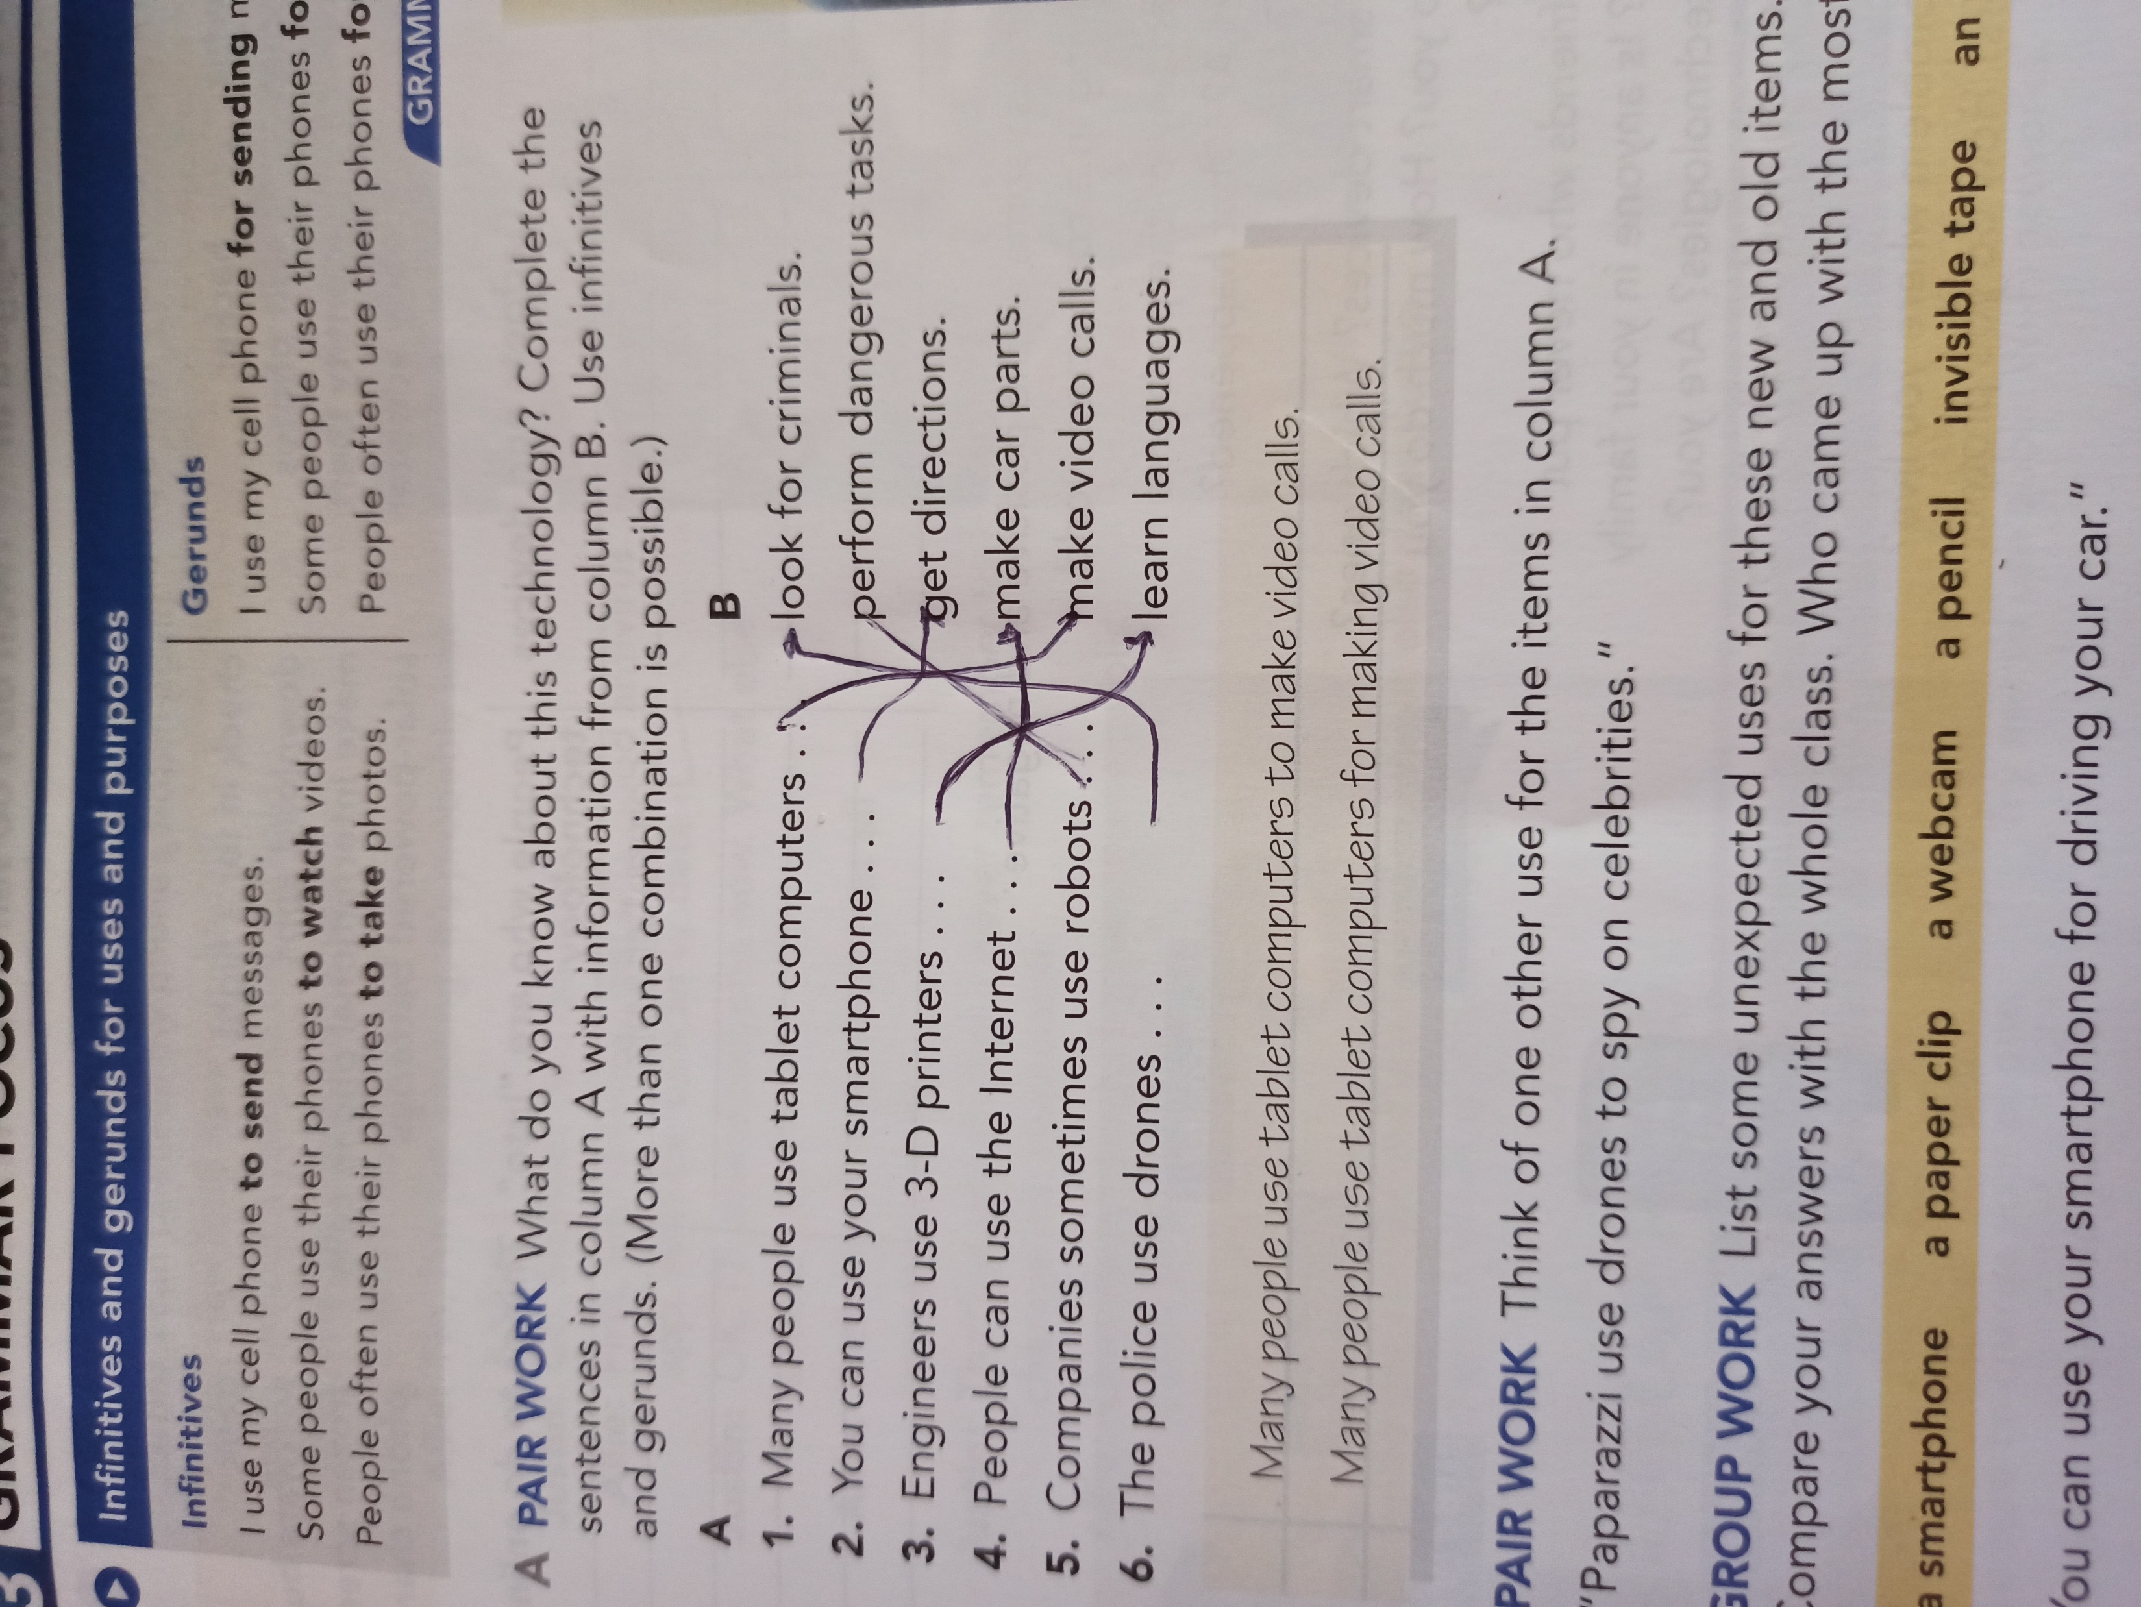
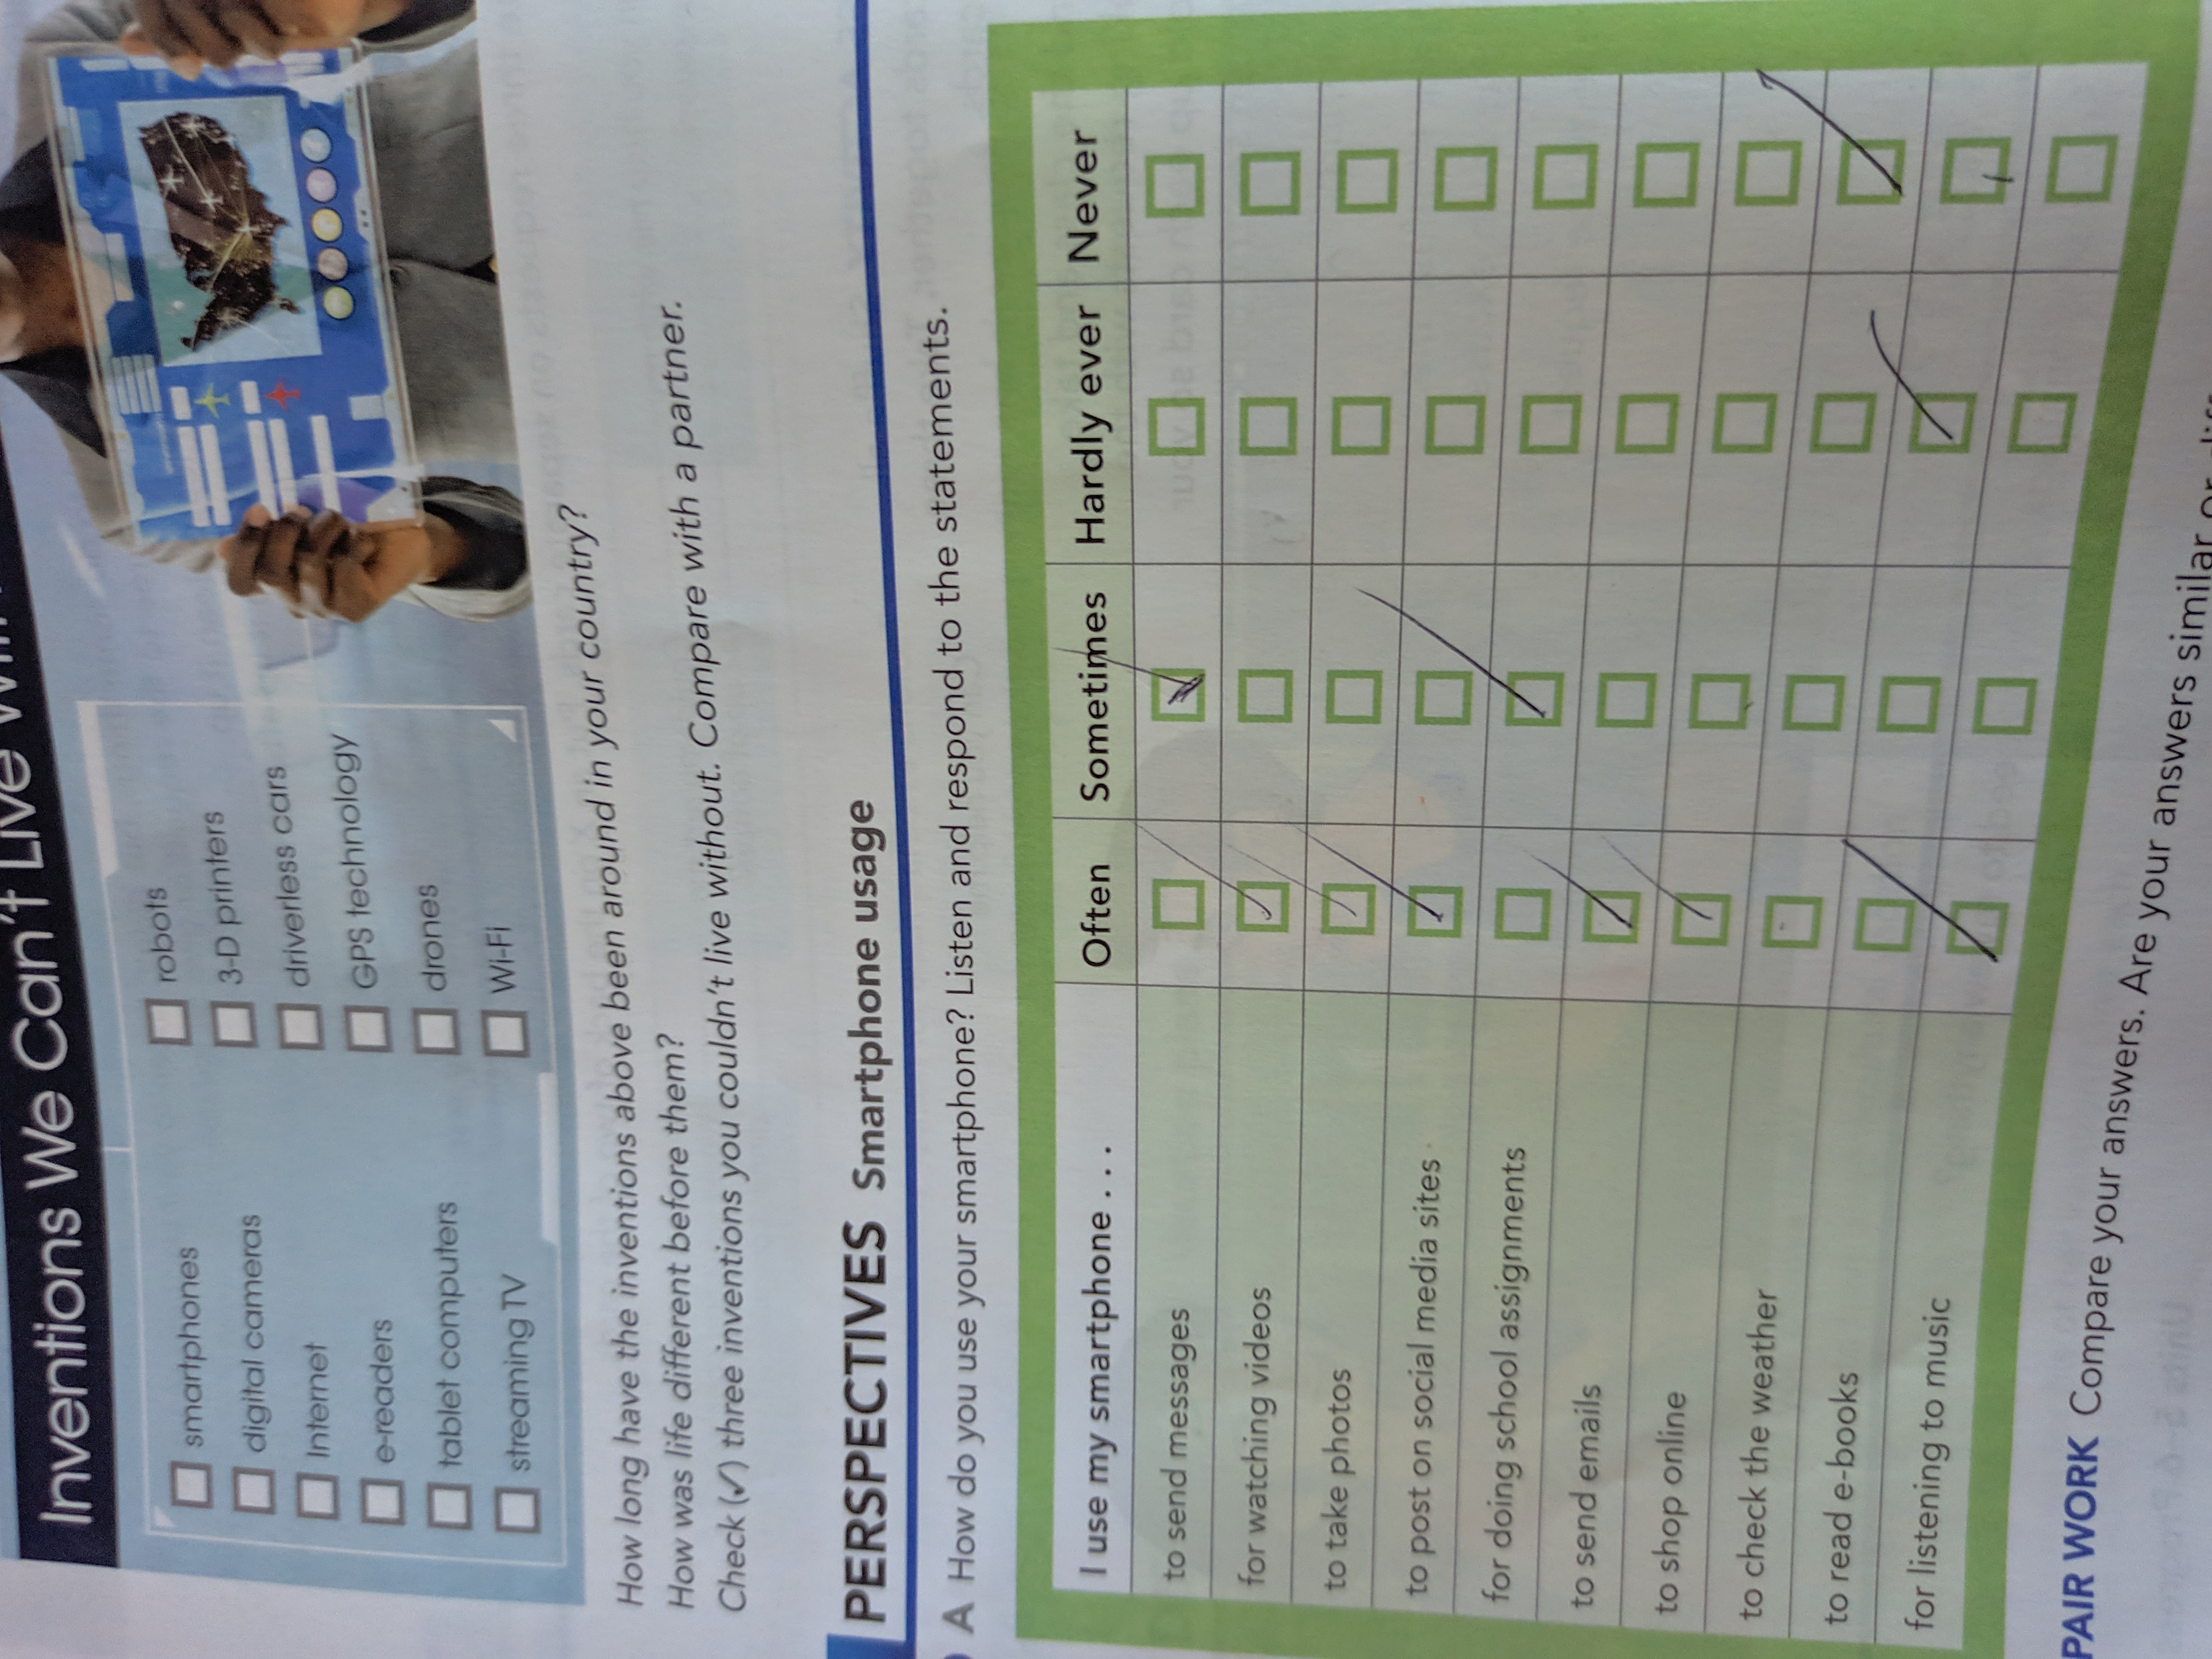
6th

